Slide 1
Build a (real) webpart
Joon du Randt
@joon_net

Slide 2




Instructions here: http://bit.ly/lkmugprep
Install the pre-requisites for this session
bit.ly
LK
MUG
PREP

Slide 3

Revision
What’s the SharePoint Framework again?

Slide 4
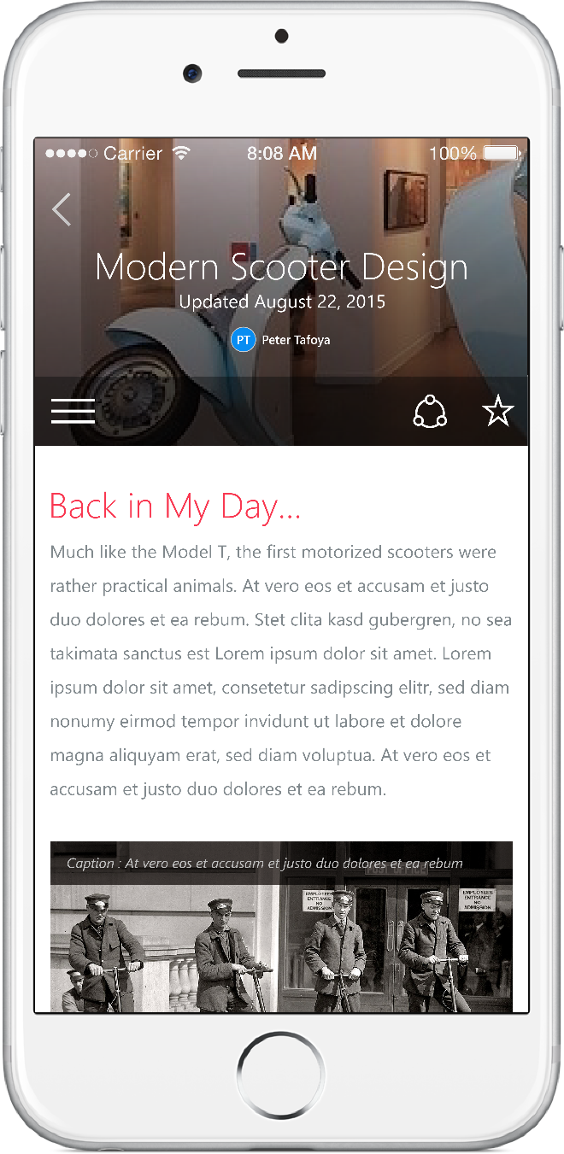
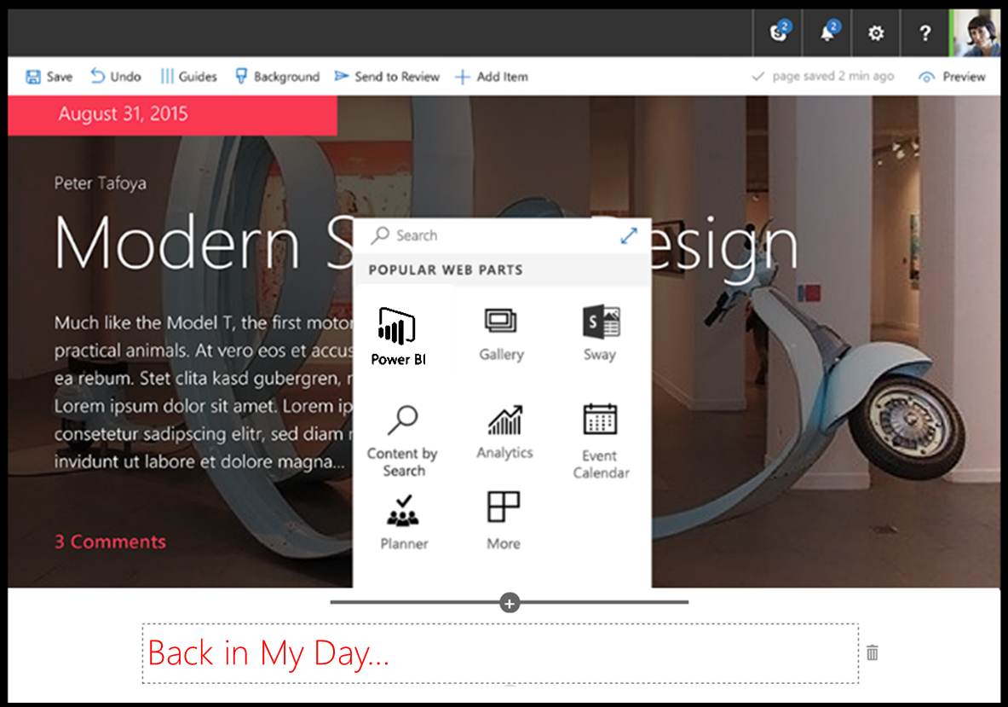
SharePoint Framework
Modern client-side development
Lightweight web and mobile
Powers our own experiences
Backward compatible
Supports open source tools and JavaScript web frameworks
SharePoint framework
Microsoft Graph
LOB Systems and Cloud Services
Notes:
Built into the SharePoint mobile apps

Slide 5
What’s a modern page?
Client-side rendered
Natively responsive
Client-side web parts
Client-side and persisted caches
Mobile optimized
Notes:
Client-side rendered using Open Source web tech, predominantly React and Office Fabric
CDN deployed “single-page” web apps with client side interactivity and fast page routing
Client-side web parts
Client-side and persisted caches
Mobile optimized (responsive)

Slide 6

Sharing is caring…
Code samples and solutions
Reusable components
Guidance documentation
Monthly community calls
SharePoint Framework
SharePoint add-ins
Microsoft Graph
Office 365 APIs
http://aka.ms/SharePointPnP

Slide 7

Overview of what we’re building

Slide 8




Employee Applies
Hiring Manager reviews application
Application is approved or denied

Slide 9

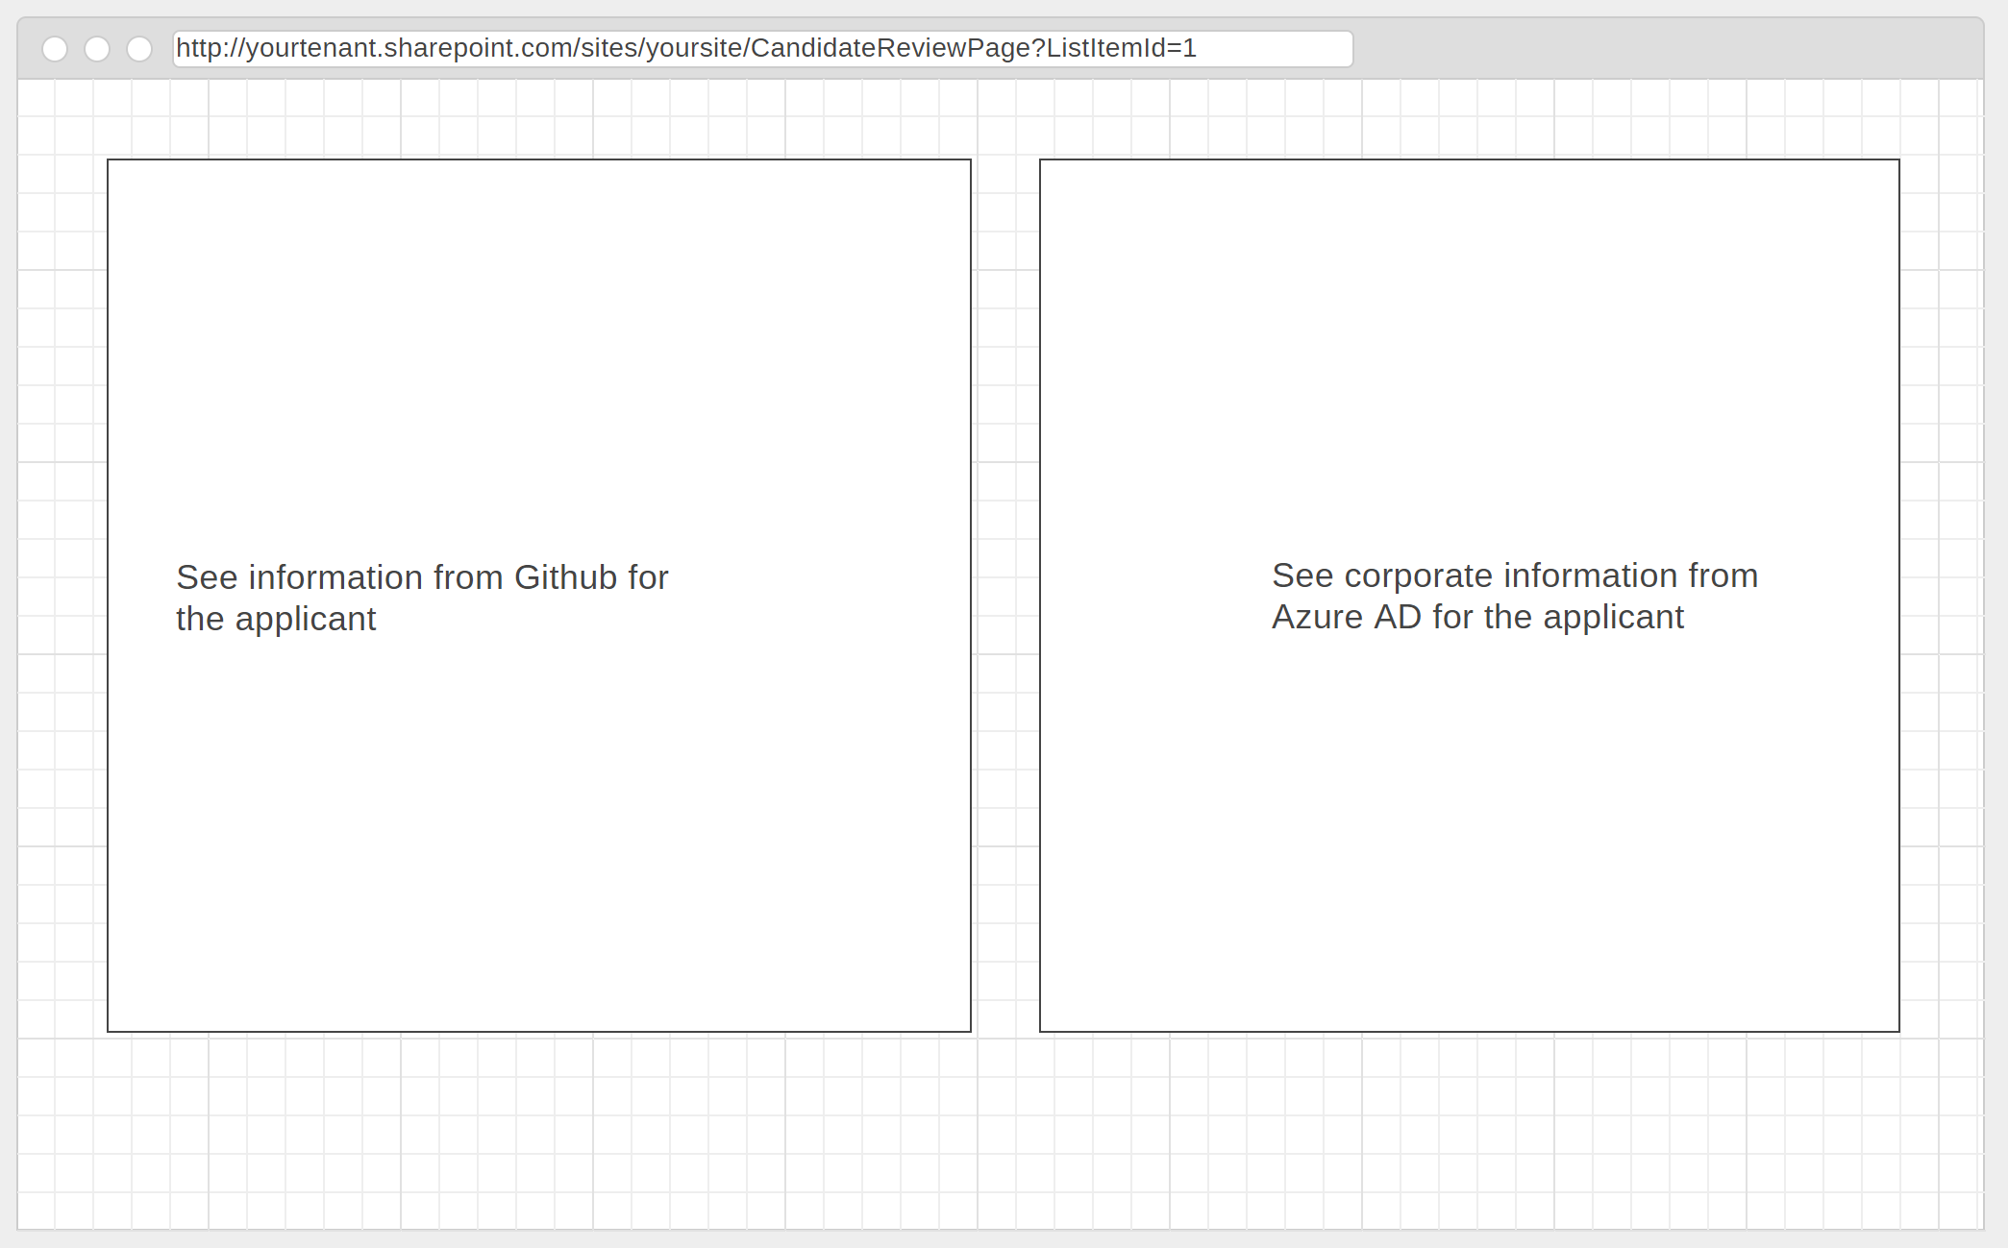
Reviewer Clicks

Slide 10


Hosted on a modern page
Page URL (with a QueryString at the end)
Read Query String
Candidate List
Access candidate info
SPFX Web Part - container
GitHub Information Display
GitHub Data Provider
Access GitHub info

Slide 11

Implement the code

Slide 12
Implement the URL and SharePoint list item access
Open your code editor
Open the file “CodeSnippets1.txt” in a text editor
Follow along…

Slide 13
Implement the GitHub display web part
Open the file “CodeSnippets2.txt” in a text editor
Now follow along

Slide 14
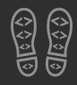
Up next: Lunch! Then: Intro to the MS Graph

Slide 15

Call to action
(Recommendation to Bootcamp organizers and speakers: This slide can be used at the end of the Bootcamp to have attendees to fill online feedback form and recommendation for their ongoing learning and app development on Office 365 platform. Please keep the first three bullet points, you can update the last bullet point to be the user group or community that you are leading that you’d like attendees to join and learn more. Please keep the first feedback bullet point at the top and feel free to re-arrange the rest of bullet point orders. Thanks.
Share your feedback on Bootcamp at https://aka.ms/o365devbootcampfeedback
Join Office 365 developer program https://dev.office.com/devprogram to leverage all resources for Office 365 development learning
Build applications on Office 365 platform
Attend MVP led local community events to continue learning on Office 365 development

